Slide 1
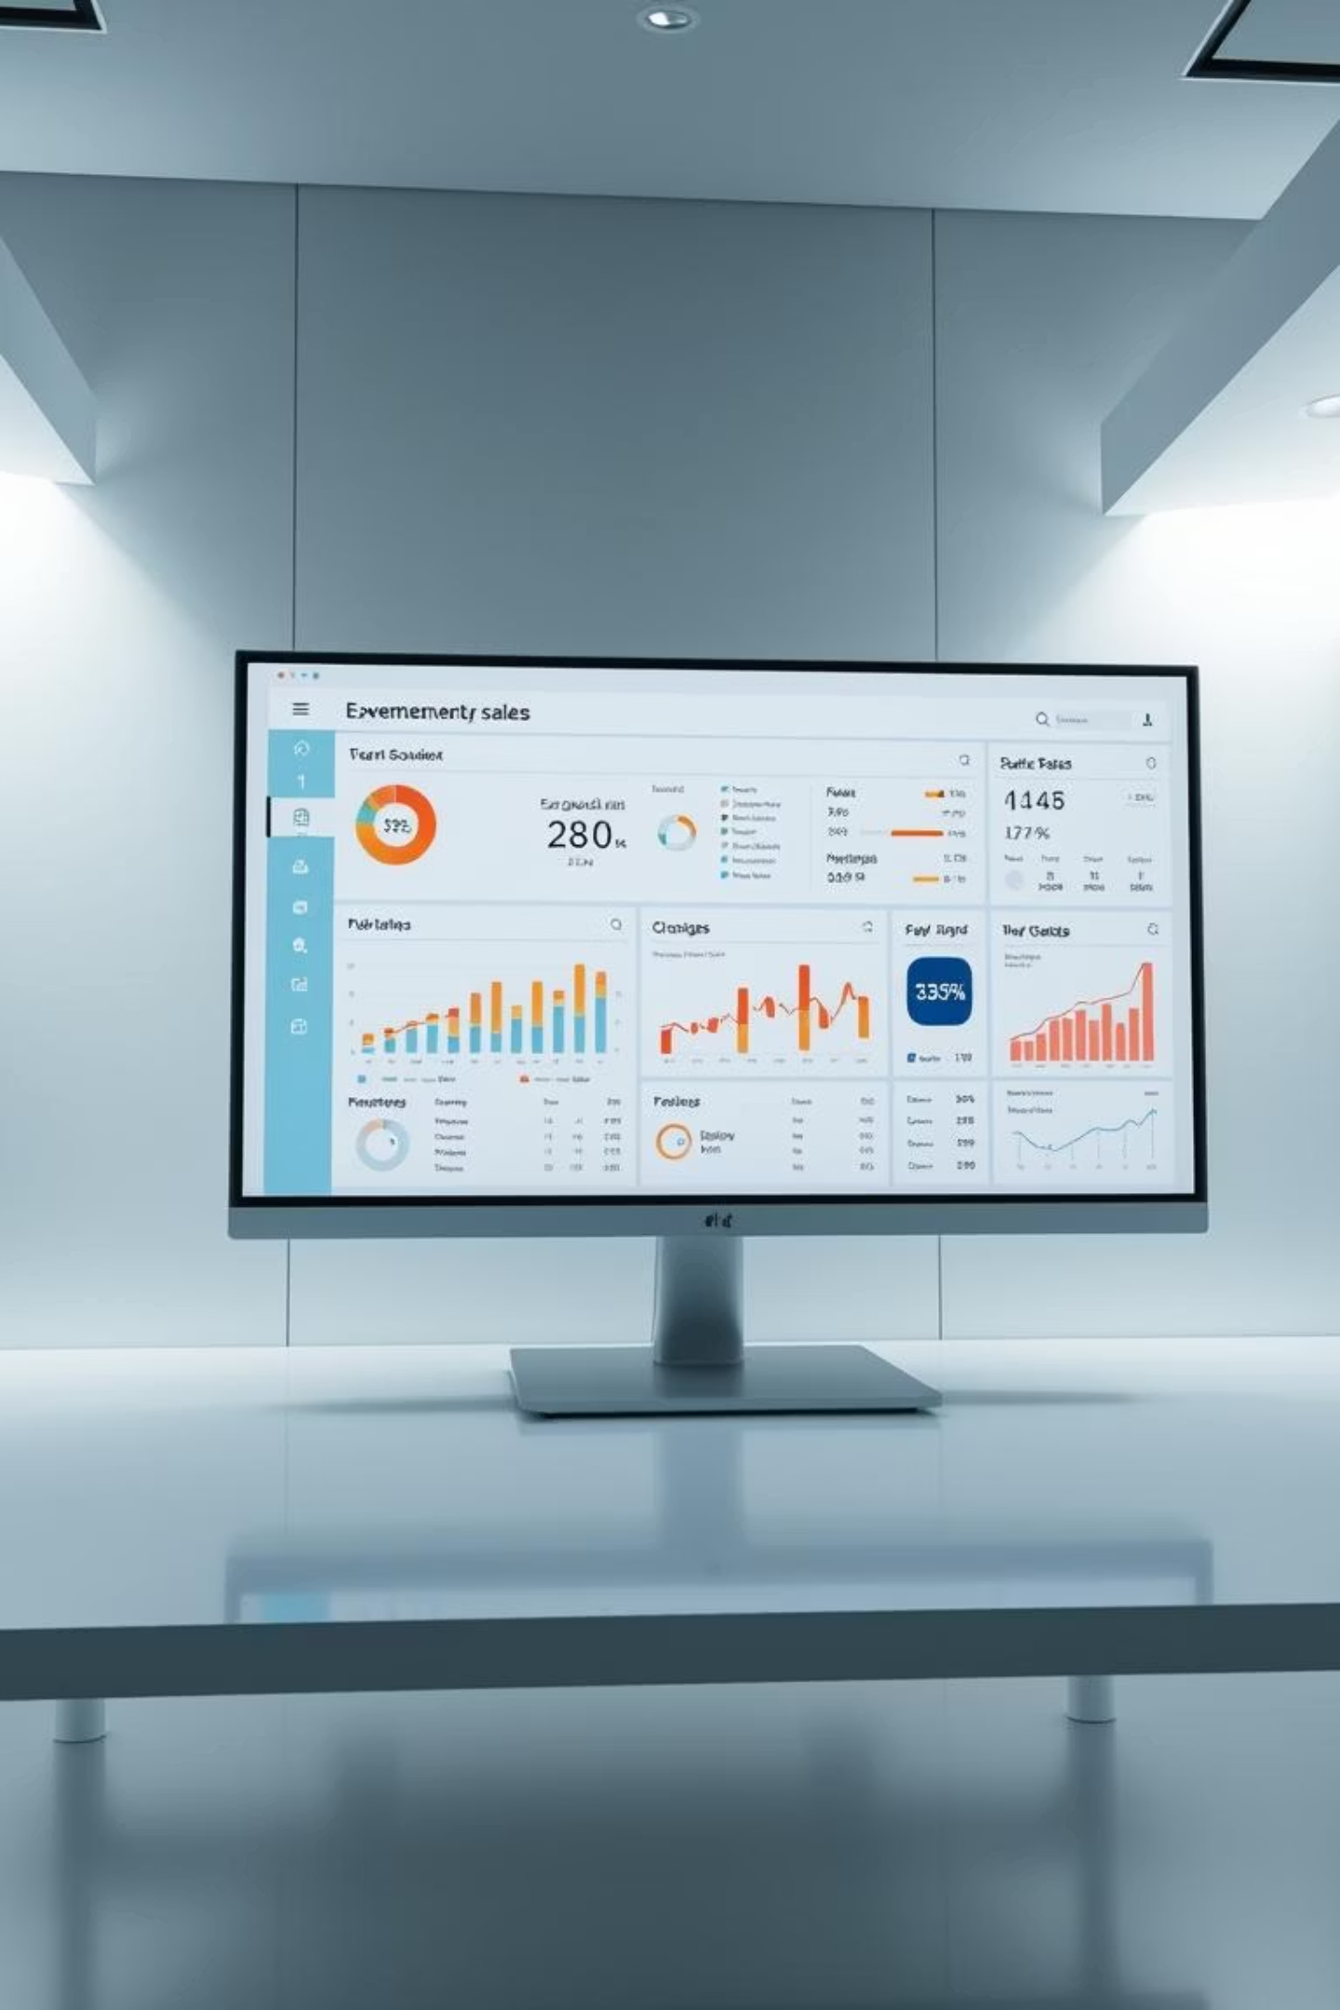
E-Commerce Sales Dashboard using Power BI
This presentation details the creation of an interactive E-commerce Sales Dashboard using Power BI, developed as part of a Data Analyst Internship Task.
Name: Rasika Mahindrakar
Date: 30-05-2025

Slide 2

Project Objective: Driving Data-Driven Decisions
The primary objective of this project was to transform raw E-commerce sales data into actionable insights through robust analysis and compelling visualizations. The goal was to empower stakeholders with an interactive tool for informed decision-making.
1
2
3
Analyze & Visualize Sales Data
Uncover Key Business Insights
Build Interactive Dashboard
Develop a dynamic and user-friendly dashboard that allows for seamless exploration of data, facilitating strategic business decisions.
Conduct comprehensive analysis of E-commerce sales data to identify trends, patterns, and anomalies.
Extract meaningful business insights by leveraging Power BI's analytical capabilities, focusing on profitability and sales performance.

Slide 3
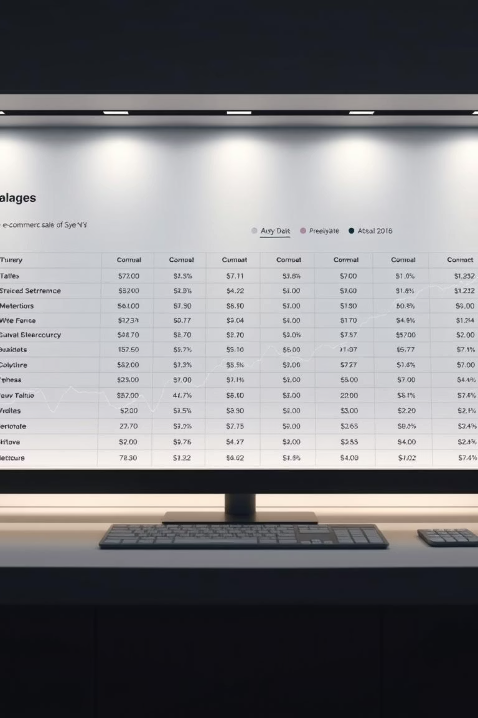
Dataset Overview: A Comprehensive Look at E-commerce Sales
The analysis was based on a rich E-commerce sales dataset, providing a granular view of transactional activities. This dataset served as the foundation for uncovering crucial sales trends and customer behaviors.
Key Transactional Details:
Order & Customer Data:
Amount, Average Order Value (AOV)
Order ID, Order Date
Customer Name, City, State
Quantity, Profit
Payment & Unique Identifiers:
Product & Category Information:
Payment Mode, ID (Unique Identifier)
Category, Sub-Category

Slide 4



Key Insights and KPIs: Measuring Performance
The dashboard was designed to highlight critical performance indicators and trends, providing a clear picture of the E-commerce business's health. DAX measures were instrumental in calculating precise metrics.
Monthly Trends
Top Performers
DAX Metrics
Tracked monthly sales and profit trends to identify periods of growth or decline, enabling proactive adjustments.
Identified top-selling products and high-performing categories to inform inventory and marketing strategies.
Calculated Total Sales, Total Profit, Quantity Sold, and Average Order Value (AOV) for a holistic performance view.

Slide 5

Dashboard Features: Interactive and Informative
The E-commerce Sales Dashboard incorporates a range of interactive features and diverse visualizations to enhance user experience and facilitate deep-dive analysis. This ensures that users can quickly find the information they need.
Interactive Filters & Slicers
Diverse Chart Types
KPI Cards
Filters for Quarter, State, and Category enable dynamic data exploration and focused analysis.
Utilized Line, Bar, Donut, and Column Charts to present various aspects of sales data effectively.
Dedicated cards display key performance indicators such as Total Profit, Quantity, and AOV for at-a-glance insights.

Slide 6

Tools & Techniques Used: Building the Dashboard
The development of the E-commerce Sales Dashboard leveraged a powerful suite of Microsoft tools and demonstrated a comprehensive application of data analytics skills, from raw data to compelling visualizations.
Core Tools
Applied Skills
Power BI: For interactive dashboard creation and data visualization.
Data Modeling: Structuring data for optimal analysis and relationships.
Power Query: Essential for data cleaning, transformation, and shaping.
Data Cleaning & Transformation: Ensuring data quality and usability.
DAX (Data Analysis Expressions): For complex calculations and custom measures.
Custom Visualizations: Designing tailored charts and graphs for specific insights.
Dashboard Design: Creating intuitive and aesthetically pleasing layouts.

Slide 7
Learnings: Growth and Skill Enhancement
This project offered significant learning opportunities, enhancing my proficiency in data analysis and visualization. It emphasized the importance of a structured approach to data management and compelling data communication.
Data Integration Expertise
Interactive Analysis
Mastered creating connections and joining disparate tables using Power Query for comprehensive data integration.
Gained proficiency in using parameters and filters to enable dynamic drill-down analysis and user interaction.
Data Storytelling
Design Principles
Enhanced skills in effectively communicating complex data insights through compelling narratives and visual presentation.
Developed a keen understanding of balancing aesthetics with usability in dashboard design, ensuring both appeal and functionality.

Slide 8
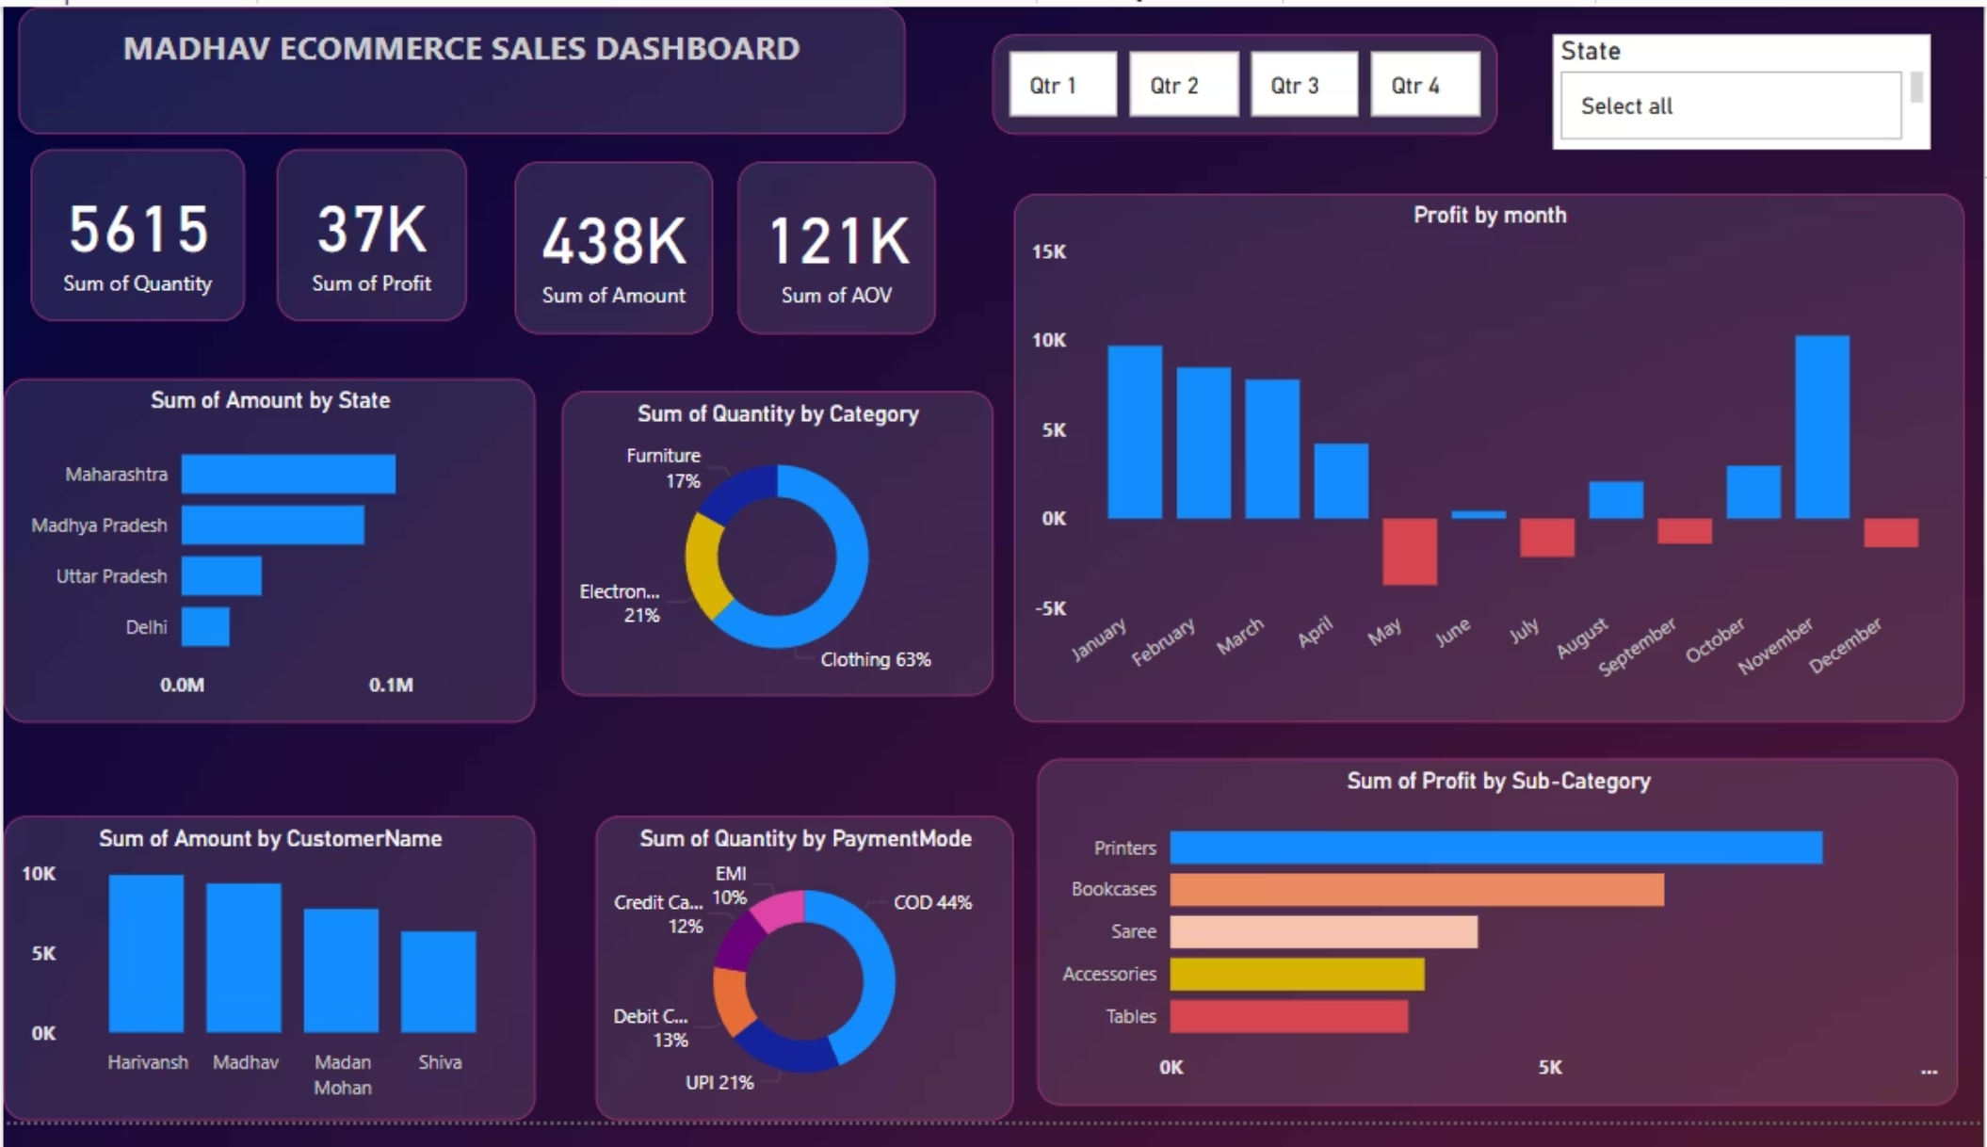
Dashboard Preview: A Glimpse into Interactive Insights
The dashboard features interactive
elements, allowing users to filter data by quarter, state, and category. Key performance indicators are highlighted in distinct cards, while a variety of charts visualize sales and profit trends, top products, and geographical performance.

Slide 9
Conclusion: Empowering Business with Data
This project not only refined my technical skills in data analysis and visualization but also reinforced the impact of presenting data clearly and interactively. The dashboard delivered is a testament to the power of data storytelling in supporting strategic business objectives.
01
02
03
Skill Reinforcement
Tangible Deliverable
Impactful Storytelling
Significantly strengthened my data analysis, modeling, and visualization capabilities in a practical application.
Successfully delivered a clear, intuitive, and interactive dashboard directly beneficial for business stakeholders.
Demonstrated the critical role of Power BI and effective data storytelling in transforming raw data into actionable business intelligence.

